Slide 1

MINOR PROJECT PRESENTATION
Department of Computer Science and Engineering,
R V College of Engineering, Bengaluru

Slide 2
IMPLEMENTATION OF A DEFENSE MECHANISM FOR SYN FLOOD ATTACK
Guided by:
Dr. Sowmyarani C. N.
Associate Professor, Dept. of CSE, RVCE
Submitted by:
Akash Hegde – 1RV18SCN01
Krithika L – 1RV18SCN08

Slide 3
AGENDA
Introduction
Objectives
Literature Survey
Methodology
Design
Experimental Setup
Demonstration
Experimental Results
Comparative Analysis
Conclusion
Future Enhancements

Slide 4
INTRODUCTION
SYN Flood attack – a form of denial-of-service (DoS) attack.
Here the attacker sends a succession of SYN requests to a target’s system.
An attempt is made to consume enough server resources to make the system unresponsive to the legitimate traffic.

Slide 5
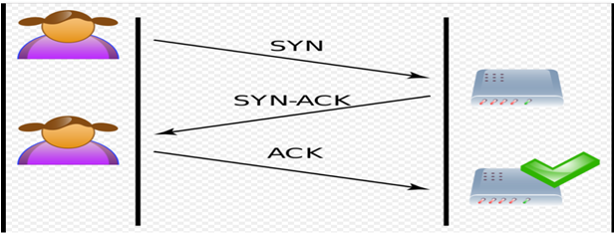

INTRODUCTION

Slide 6
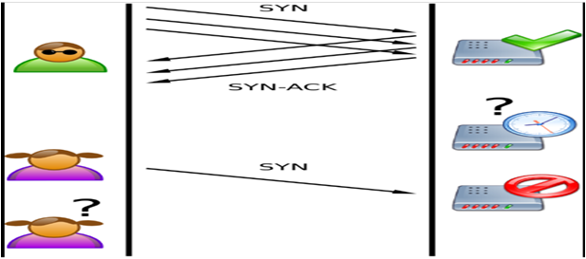
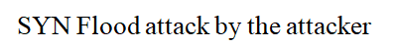
INTRODUCTION

Slide 7
OBJECTIVES
Understand the working of SYN Flood attack and its effects on legitimate users of the system.
Goal – provide a better solution for defending against a SYN Flood attack using iptables rules with minimum configuration and faster execution.

Slide 8
LITERATURE SURVEY
Sl.No | Authors and Publications | Topic
01 | Ryosuke Nagai, et al., IEEE Transactions, Oct. 2018. | "Design and Implementation of OpenFlow-based TCP SYN Flood Mitigation"
02 | Tran Manh Thang, et al., IEEE ACDT, Oct. 2018. | “Synflood Spoofed Source DDoS Attack Defense Based on Packet ID Anomaly Detection with Bloom Filter"
03 | Kavisankar L, et al., International Journal on Recent Trends and Challenges in Computational Models, Jul. 2017. | “Efficient SYN Spoofing Detection and Mitigation Scheme for DDoS Attack"
04 | D. Deepthi Rani, et al., International Journal of Computer Trends and Technology, Oct. 2013. | "TCP SYN Flood Attack Detection And Prevention"
05 | Bahaa Qasim M. Al-Musawi, International Journal of Engineering and Technology, Jun. 2012. | "Mitigating DoS/DDoS Attacks using iptables"

Slide 9
LITERATURE SURVEY
Title and Year | Objectives/ Methodology | Limitations | Future Scope
"Design and Implementation of OpenFlow-based TCP SYN Flood Mitigation" (2018) | Mitigation mechanism built into the infrastructure using OpenFlow. Centralized and flexible network management. Behaviour of packets decided by the controller software. | Entries in flow tables exhausted if DDoS attack exceeds resources of OpenFlow switch. Overhead of processing the controller leads to performance loss. | Switch-level redesign will improve performance and reduce overhead.

Slide 10
LITERATURE SURVEY
Title and Year | Objectives/ Methodology | Limitations | Future Scope
“Synflood Spoofed Source DDoS Attack Defense Based on Packet ID Anomaly Detection with Bloom Filter" (2018) | Packet Identification Anomaly Detection (PIDAD) to detect spoofed packets. Multi-layer Bloom Filter to determine the packets that have been sent from different IP. | To determine the packet to be real or not, the method needs to collect at least 3 times of packets sent to the system. It needs to store the info of 45 million values. | Efficient storage of packet information such that it provides faster access.

Slide 11
LITERATURE SURVEY
Title and Year | Objectives/ Methodology | Limitations | Future Scope
“Efficient SYN Spoofing Detection and Mitigation Scheme for DDoS Attack" (2017) | Efficient Spoofed Mitigation Scheme(ESMS) is used that uses TCP probing. Provides accurate information regarding the spoofed packets during DDoS attacks. | Host-based solution. There maybe attacks in the backbone networks also. | Getting the spoofed packets in the router itself.

Slide 12
LITERATURE SURVEY
Title and Year | Objectives/ Methodology | Limitations | Future Scope
"TCP SYN Flood Attack Detection And Prevention" (2013) | Efficient packet filtering technique using firewall to defend TCP SYN Flood attacks. Firewall scripts are written using command-line tool iptables in Linux to deny the suspicious traffic. | iptables are complex. Vast iptables are difficult to maintain and affect the performance. | Improving the performance of the system by using modified iptables.

Slide 13
LITERATURE SURVEY
Title and Year | Objectives/ Methodology | Limitations | Future Scope
“Mitigating DoS/DDoS Attacks using iptables” (2012) | Efficient packet filtering technique using packet analyzer tool. Packet Analyzer tool used to show the effectiveness of the scripts in mitigating the attack. | Depends on the traffic rate of the IP addresses sending the packets. iptables rely on set of predefined rules. | Application of iptables within openwrt. Adaptive iptables rules concept.

Slide 14
METHODOLOGY
Environment set up with multiple virtual machines (VMs) - one target, two or more attackers.
Two stages of implementation -
Perform DDoS attack on target.
Implement defense mechanism at target and run attack again.

Slide 15
DESIGN
Designed in Python using scapy framework.
Functions present in scapy to manually craft abnormal packets with desired field values.
Abnormal packets sent to target from the attackers by modifying iptables rules.
ID obfuscated and TCP SYN packets sent from random ports.

Slide 16
DESIGN
Observe incoming malicious packets at target.
Suspicious TCP packets rejected with a TCP RST packet, to prevent further DDoS.
Create iptables rules for defense – add the malicious IPs to be rejected.
Logs maintained for tracking purposes.

Slide 17
EXPERIMENTAL SETUP
Virtual Machines (VMs) setup on the Oracle VirtualBox 6.0.8.
VMs configured with host-only network adapters.
Ubuntu 16.04 LTS OS (Linux) used for the VMs.
Two types of attack environments:
single attacker, single target (DoS)
multiple attackers, single target (DDoS)
Python 3.6 with Scapy 2.4 used to script the SYN flood attack.

Slide 18
EXPERIMENTAL SETUP
Source ports – randomized.
Destination ports – 22 (SSH) and 80 (HTTP).
Shell script written to defend against the SYN Flood attack.
iptables rule chains to accept/reject packets over the ports.
Wireshark packet analyzer tool used to capture and analyze the packets.

Slide 19
DEMONSTRATION
Packet generated by srloop function in scapy.
SYN
SYN replied back by target system with SYN-ACK.
SYN-ACK
Attacker’s system kernel RST packet blocked by iptables.
RST
X
SYN-ACK
No RST received from attacker for the random ports. Send SYN-ACK again.
SYN-ACK
SYN-ACK
Attacker
Target
Without Defense Mechanism

Slide 20
DEMONSTRATION
Packet generated by srloop function in scapy.
SYN
SYN replied back by target system with SYN-ACK.
SYN-ACK
Attacker’s system kernel RST packet blocked by iptables.
RST
X
No RST received from attacker for the random ports. Send SYN-ACK again.
SYN-ACK
RST
After specific time interval, target server sends RST packets to all connections in WAIT state using iptables.
RST
Attacker
Target
With Defense Mechanism

Slide 21
DEMONSTRATION
Individual VMs booted up.
Wireshark opened in target system – checking for received packets.
iptables rules defined to accept the packets.
Attack script run on one attacker VM (DoS).
Output observed in Wireshark and log files.
Attack script run on all the VMs (DDoS).
Output observed in Wireshark and log files once again.

Slide 22
DEMONSTRATION
Defense shell script run in the target VM.
Attack script run in all the VMs together.
Final output observed in Wireshark and the log files.

Slide 23
EXPERIMENTAL RESULTS
SYN flood occurs extremely fast due to less intervals and time-to-live (TTL) value.
Continuous RST+ACK observed in output without defense mechanism → buffer overflow.
Continuous RST+ACK observed in output with defense mechanism → packets rejected.
iptables allow easier filtering of the packet flow – only necessary packets are allowed into the network.

Slide 24
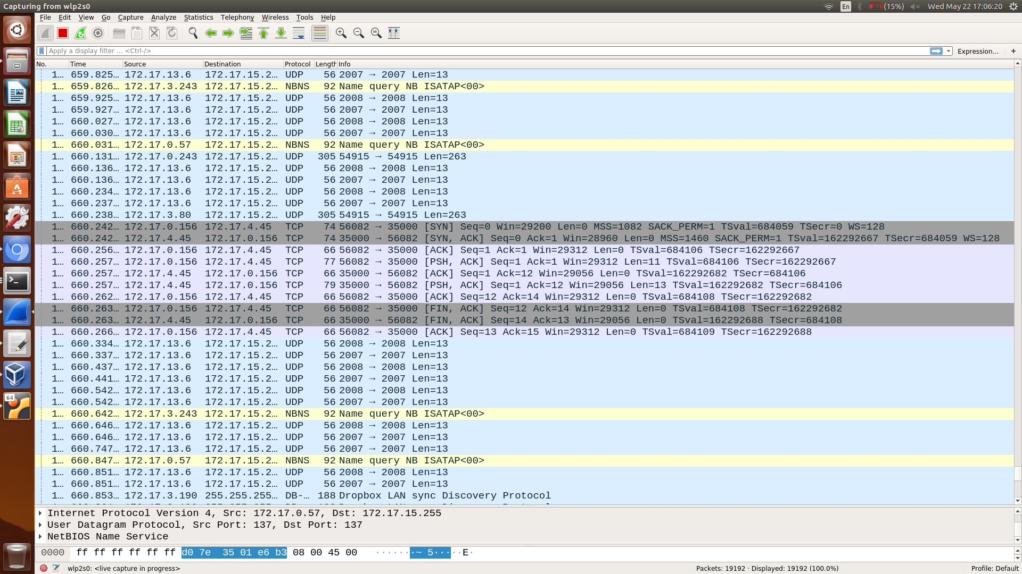
EXPERIMENTAL RESULTS
TCP 3-way Handshake

Slide 25
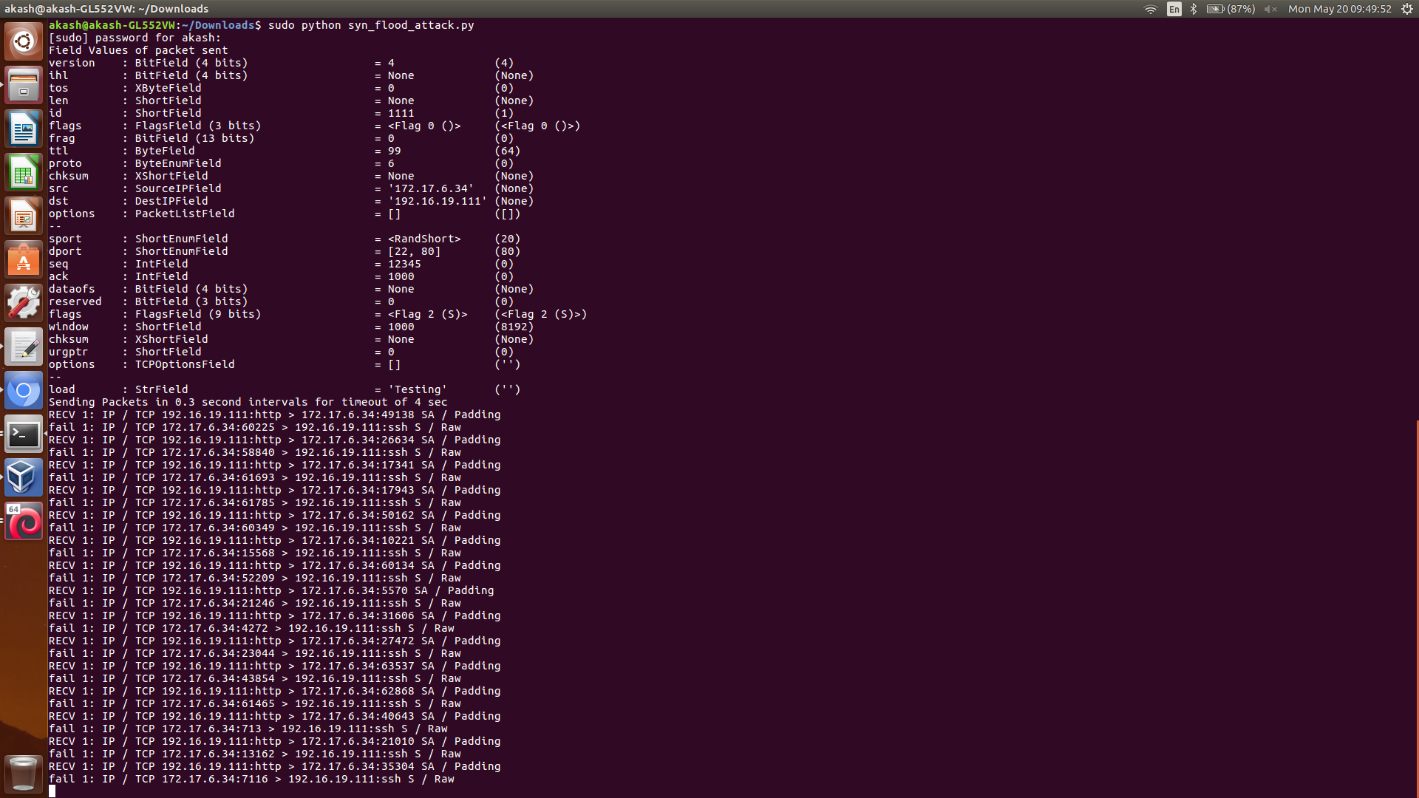
EXPERIMENTAL RESULTS
Logged output for the 3-way handshake

Slide 26
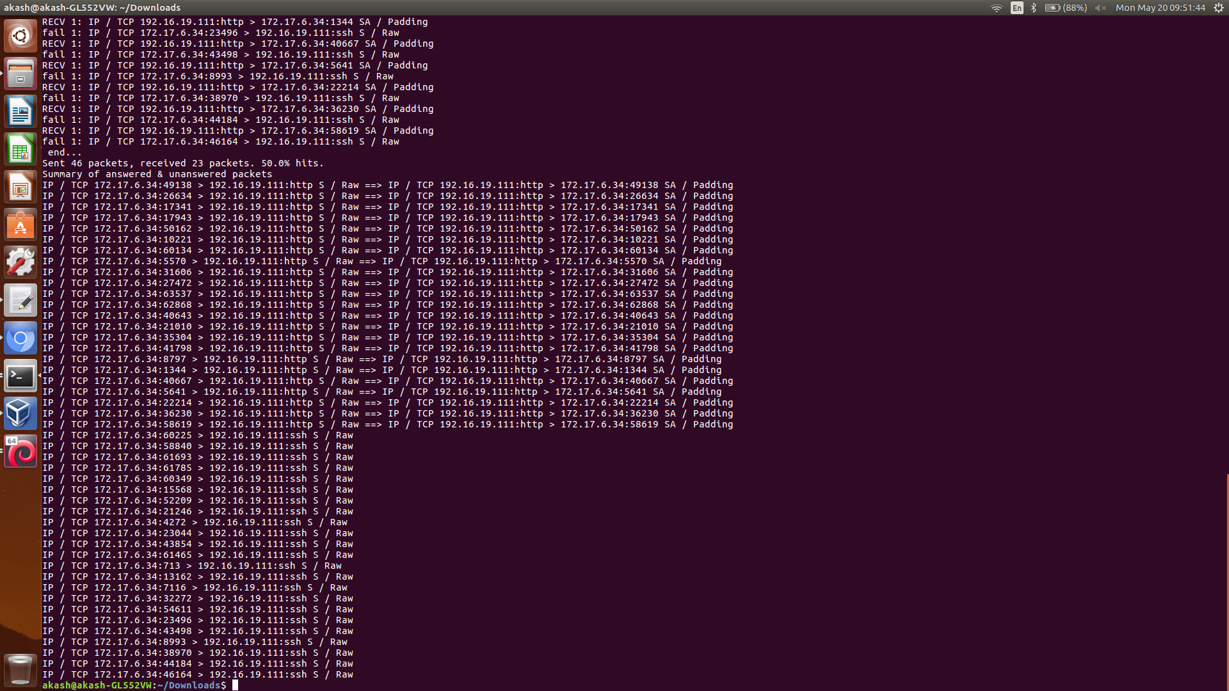
EXPERIMENTAL RESULTS
Summary of the transmitted packets

Slide 27
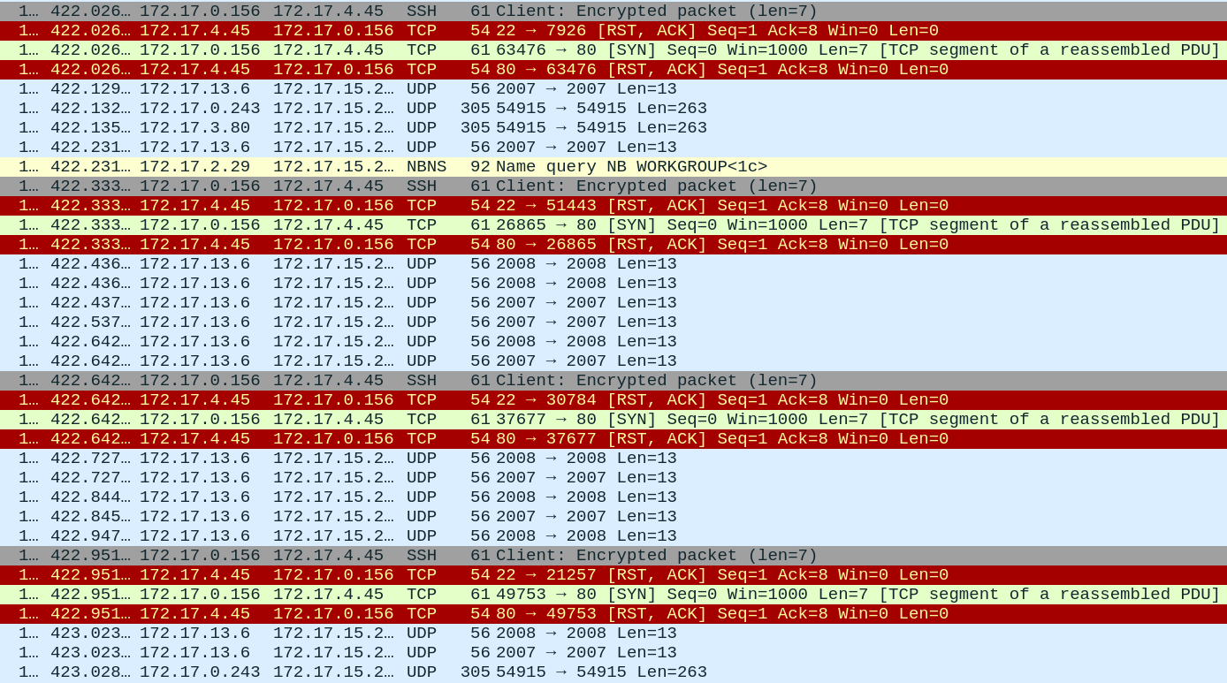
EXPERIMENTAL RESULTS
RST-ACK received upon SYN flooding

Slide 28
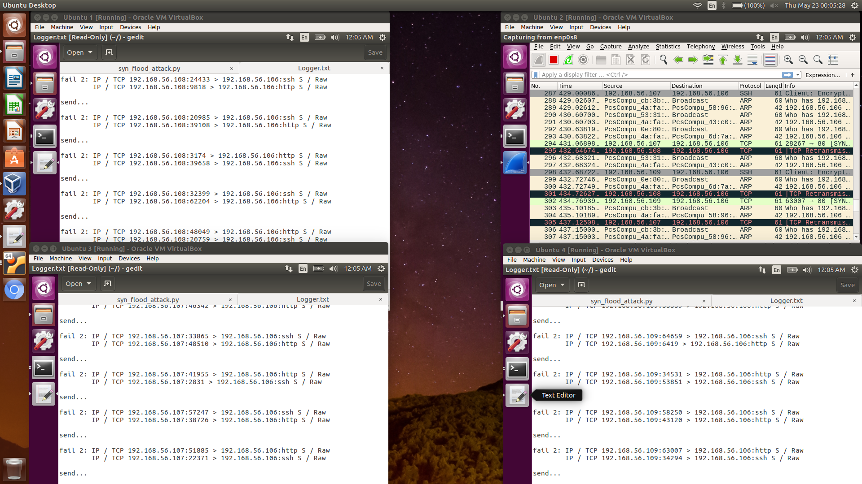
EXPERIMENTAL RESULTS
DDoS Implementation of SYN Flood

Slide 29
COMPARATIVE ANALYSIS
SYN Flood compared against ICMP Flood (Ping of Death) with respect to attack time and average round trip time (RTT).
Similar environment setup as SYN Flood – multiple attackers, one target.
Ping commands run on the attacker machines and output observed at the target via Wireshark.

Slide 30
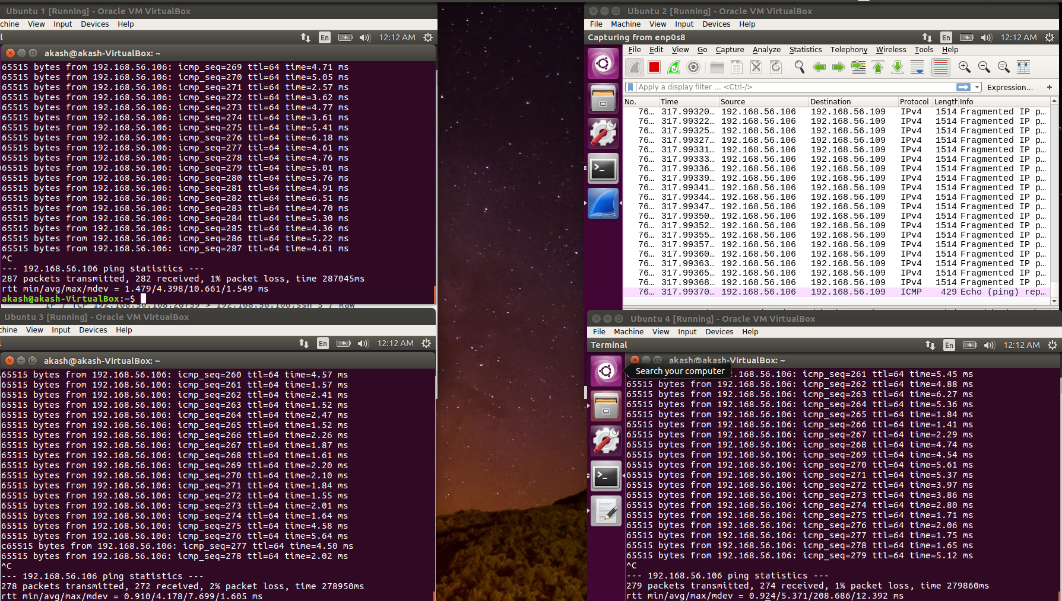
COMPARATIVE ANALYSIS
Implementation of ICMP Flood

Slide 31
COMPARATIVE ANALYSIS
Total attack time observed to be lesser for SYN Flood than ICMP Flood (No. of packets = 100).
Trials (No. of packets = 100) | Total Attack Time for SYN Flood | Total Attack Time for ICMP Flood
Trial 1 | 31.56 s | 92.74 s
Trial 2 | 30.78 s | 93.98 s
Trial 3 | 31.73 s | 91.54 s
Trial 4 | 29.43 s | 92.09 s
Trial 5 | 30.21 s | 93.17 s

Slide 32
COMPARATIVE ANALYSIS
Total attack time observed to be lesser for SYN Flood than ICMP Flood (No. of packets = 200).
Trials (No. of packets = 200) | Total Attack Time for SYN Flood | Total Attack Time for ICMP Flood
Trial 1 | 62.64 s | 189.23 s
Trial 2 | 61.12 s | 188.07 s
Trial 3 | 59.93 s | 190.35 s
Trial 4 | 60.76 s | 191.54 s
Trial 5 | 61.33 s | 189.88 s

Slide 33
COMPARATIVE ANALYSIS
Total attack time observed to be lesser for SYN Flood than ICMP Flood (No. of packets = 300).
Trials (No. of packets = 300) | Total Attack Time for SYN Flood | Total Attack Time for ICMP Flood
Trial 1 | 89.64 s | 278.95 s
Trial 2 | 91.82 s | 287.04 s
Trial 3 | 90.73 s | 279.86 s
Trial 4 | 90.01 s | 280.45 s
Trial 5 | 88.62 s | 279.08 s

Slide 34
COMPARATIVE ANALYSIS

Slide 35
COMPARATIVE ANALYSIS

Slide 36
COMPARATIVE ANALYSIS

Slide 37
COMPARATIVE ANALYSIS
Average RTT observed to be lesser for SYN Flood than ICMP Flood (No. of packets = 100).
Trials (No. of packets = 100) | Average RTT for SYN Flood | Average RTT for ICMP Flood
Trial 1 | 0.66 ms | 2.43 ms
Trial 2 | 0.68 ms | 2.54 ms
Trial 3 | 0.65 ms | 2.48 ms
Trial 4 | 0.70 ms | 2.69 ms
Trial 5 | 0.62 ms | 2.77 ms

Slide 38
COMPARATIVE ANALYSIS
Average RTT observed to be lesser for SYN Flood than ICMP Flood (No. of packets = 200).
Trials (No. of packets = 200) | Average RTT for SYN Flood | Average RTT for ICMP Flood
Trial 1 | 0.76 ms | 3.46 ms
Trial 2 | 0.78 ms | 3.39 ms
Trial 3 | 0.71 ms | 3.51 ms
Trial 4 | 0.72 ms | 3.66 ms
Trial 5 | 0.81 ms | 3.25 ms

Slide 39
COMPARATIVE ANALYSIS
Average RTT observed to be lesser for SYN Flood than ICMP Flood (No. of packets = 300).
Trials (No. of packets = 300) | Average RTT for SYN Flood | Average RTT for ICMP Flood
Trial 1 | 0.89 ms | 4.39 ms
Trial 2 | 0.98 ms | 4.17 ms
Trial 3 | 0.93 ms | 5.37 ms
Trial 4 | 0.86 ms | 5.24 ms
Trial 5 | 0.89 ms | 4.77 ms

Slide 40
COMPARATIVE ANALYSIS

Slide 41
COMPARATIVE ANALYSIS

Slide 42
COMPARATIVE ANALYSIS

Slide 43
CONCLUSION
A study is made on Denial of Service (DoS) and its distributed variant DDoS.
A brief study is made on iptables and its rules.
Flooding results in closing of established connection and TCP reset.
iptables allow for easier filtering of packets.
Total attack time and average RTT of SYN Flood is comparatively lesser than that of ICMP Flood (Ping of Death).

Slide 44
FUTURE ENHANCEMENTS
Automated setting of iptables rules from detection of malformed incoming packets.
Blacklist frequent attacking IPs and improve response time.

Slide 45
REFERENCES
[1] | Nagai R., Kurihara W., Higuchi S. and Hirots T., "Design and Implementation of an OpenFlow-based TCP SYN Flood Mitigation", IEEE International Conference on Mobile Cloud Computing, Services, and Engineering, Bamberg, Germany, 2018, pp. 37-42.
[2] | Thang T. M., Nguyen C. Q. and Nguyen V. K., "Synflood Spoofed Source DDoS Attack Defense Based on Packet ID Anomaly Detection with Bloom Filter", Asian Conference on Defense Technology (ACDT), Hanoi, Vietnam, 2018, pp. 75-80.
[3] | Kavisankar L., Chellappan C., Venkatesan S. and Sivasankar P., "Efficient SYN spoofing Detection and Mitigation Scheme for DDoS attack", International Conference on Recent Trends and Challenges in Computational Models (ICRTCCM), Tindivanam, India, 2017, pp. 269-274.
[4] | Rani D. D., Krishna T. V. S., Dayanandam G. and Rao T. V., "TCP Syn Flood Attack Detection And Prevention", International Journal of Computer Trends and Technology (IJCTT), vol. 4, issue10, 2013, pp. 3412-3417.
[5] | Al-Musawi B. Q. M., "Mitigating DoS/DDoS Attacks using iptables", International Journal of Engineering & Technology IJET-IJENS, vol. 12 issue 03, 2012, pp. 101-111.

